Slide 1
Lecture 16 Generation of Sinusoidal Voltage - 1

Slide 2
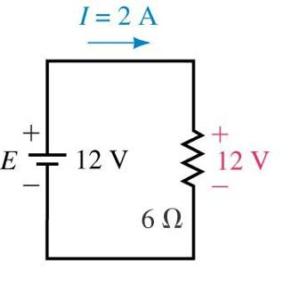
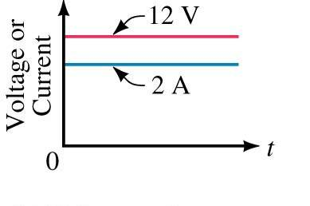
Direct Current (DC)
DC sources have fixed polarities and magnitudes.
DC voltage and current sources are represented by E and I.

Slide 3
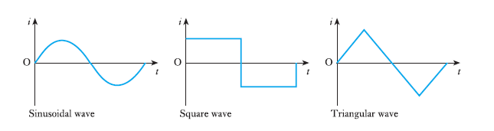
Characteristics of Alternating Current
All periodic waves can be constructed from sine waves, that is why sine waves are called fundamental waves.
Alternating voltage and Alternating current vary continuously in magnitude and reverses its polarity w.r.to time.

Slide 4
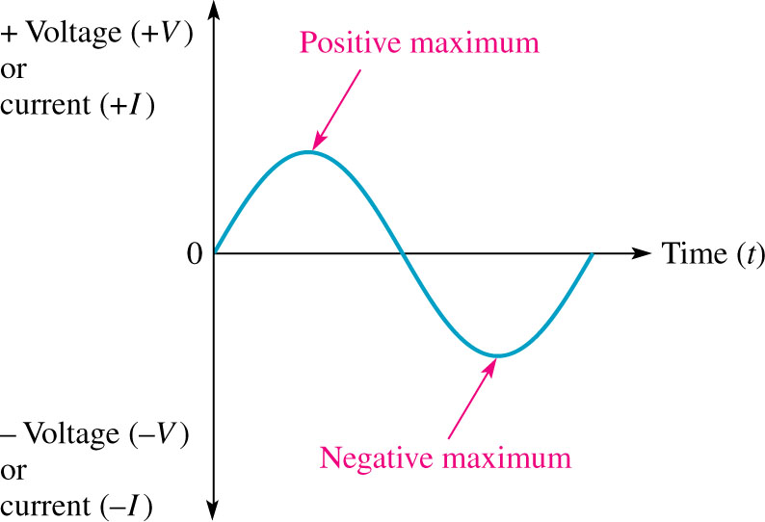
Representation of a Sinusoidal Signal
The sinusoidal waveform (sine wave) is the fundamental alternating current (ac) or alternating voltage waveform.
Electrical sine waves are named from the mathematical function with the same shape.
AC sources are represented by lowercase v(t) or i(t).

Slide 5
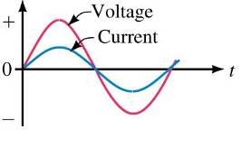
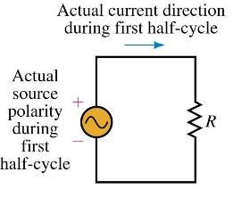
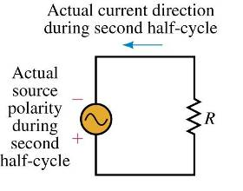
Direction of Sinusoidal AC Current
AC current changes direction each cycle with the source voltage.

Slide 6
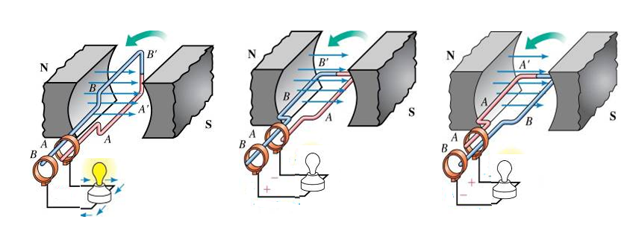
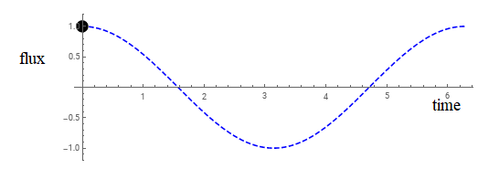
Generating AC Voltage
Rotating a coil in fixed magnetic field generates sinusoidal voltage.

Slide 7
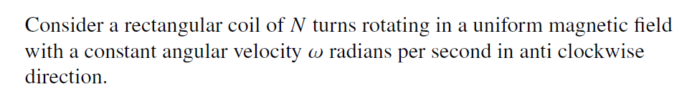
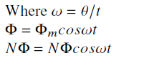
Equation of Alternating Voltage

Slide 8
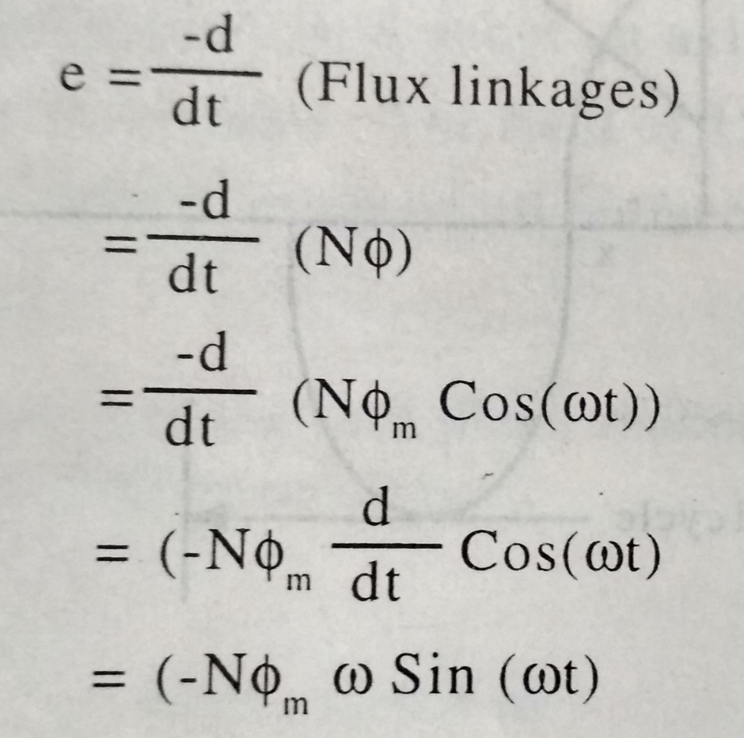
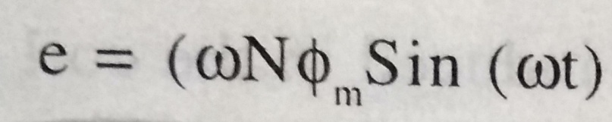
Equation of Alternating Voltage

Slide 9
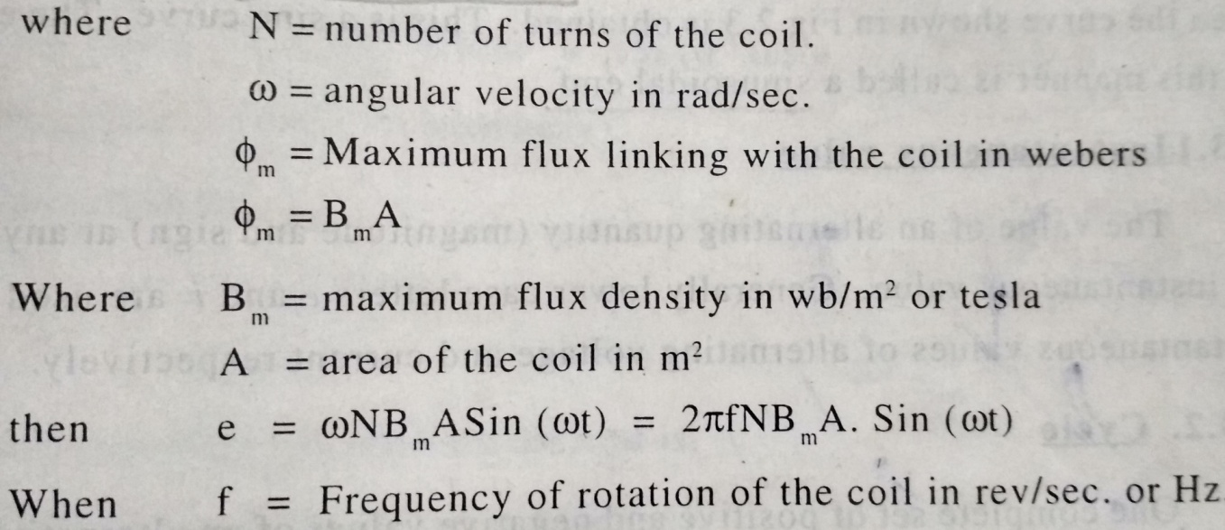
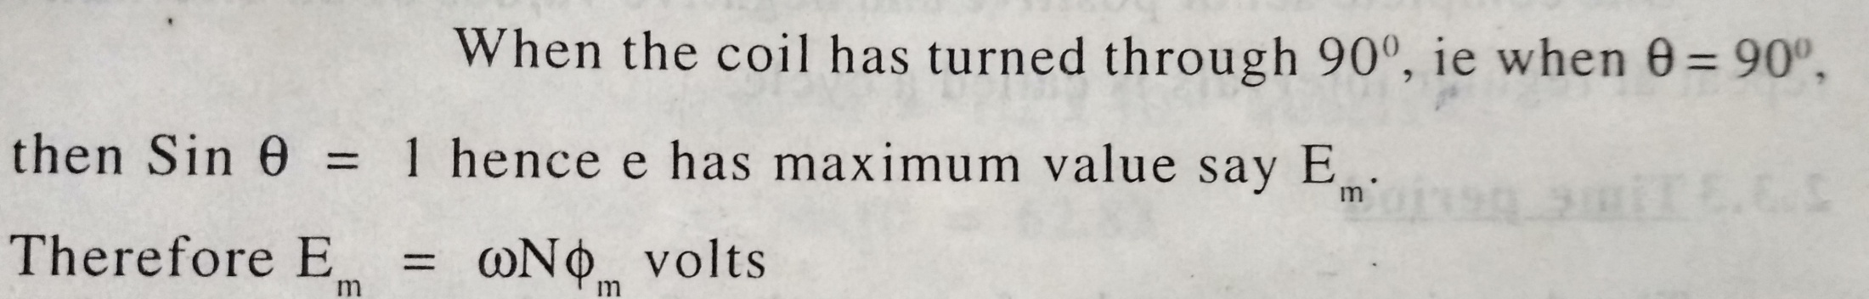
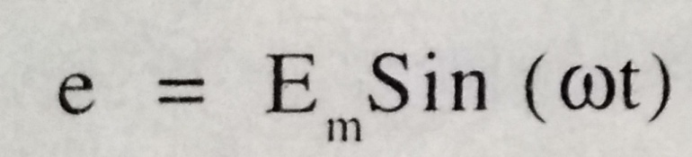
Note:
Induced emf in a coil is represented as “e(t)” and
AC voltage appled is represented as “v(t)”
Similarly peak value of induced emf is “Em” and AC voltage is “Vm”

Slide 10
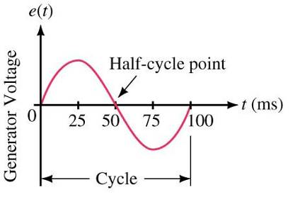
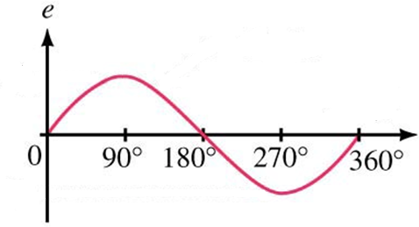
Time Scales
Horizontal scale can represent degrees or time.

Slide 11
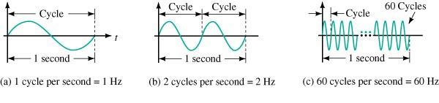
Frequency
Frequency (f) is the number of cycles per second of a waveform.
Unit of frequency is hertz (Hz).
1 Hz = 1 cycle per second.

Slide 12
Period
Period of a waveform:
Time it takes to complete one cycle.
Time is measured in seconds.
The period (T) is the reciprocal of frequency:

Slide 13
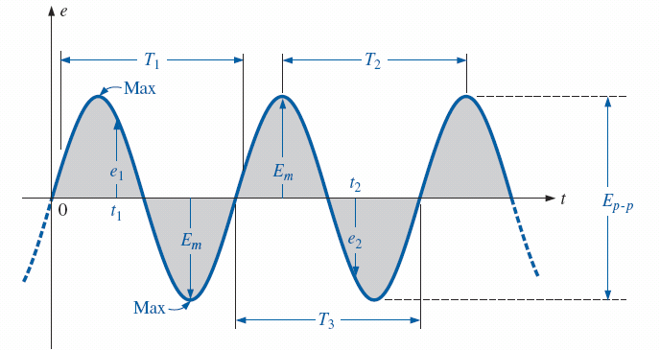
Amplitude and Peak-to-Peak Value
Amplitude of a sine wave is the distance from its average to its peak.
We use V_{m} for amplitude
Peak-to-peak voltage is measured between minimum and maximum peaks
We use V_{p-p}
Amplitude
Peak-to-Peak

Slide 14
Example Problem 1
What is the waveform’s period, frequency, V_{m} and V_{PP}?
Amplitude
Peak-to-Peak
T = 0.4s

Slide 15
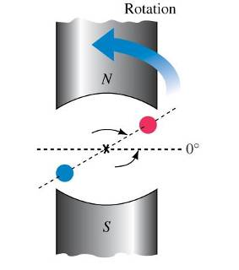
The Basic Sine Wave Equation
The equation for a sinusoidal source is given:
where V_{m} is peak coil voltage and ωt is the angular position.

Slide 16
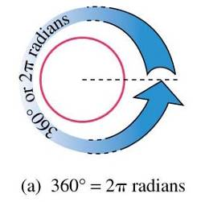
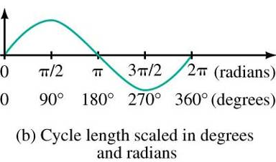
Radian Measure
Conversion for radians to degrees:
2π radians = 360º
π Radians = 180º
π/2 radians = 90º
1 radian = 57.296º

Slide 17
Angular Velocity
The rate that the generator coil rotates is called its angular velocity (ω).
Angular position can be expressed in terms of angular velocity and time.
θ= ω t (radians)
Rewriting the sinusoidal equation:
v(t) = V_{m} sin ω t (V)

Slide 18
Relationship Between ω, T and f
Conversion from frequency (f) in Hz to angular velocity (ω) in radians per second
ω = 2π f (rad/s)
In terms of the period (T)

Slide 19
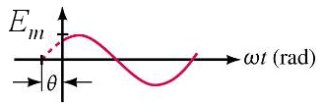
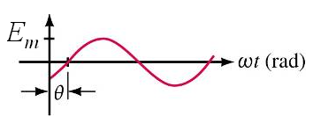
Phase Shifts
A phase shift occurs when v(t) does not pass through zero at t = 0 sec.
If v(t) is shifted left (leading), then: v = V_{m} sin (ω t + θ)
If v(t) is shifted right (lagging), then: v = V_{m} sin (ω t - θ)

Slide 20
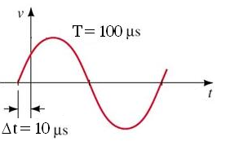
Phase shift
The angle by which the wave LEADS or LAGS the zero point can be calculated based upon the Δt.
The phase angle is written in DEGREES.

Slide 21
Phase Relationships
i leads v by 80°
i leads v by 110°
V and i are in phase

Slide 22
Thank You

